Slide 1
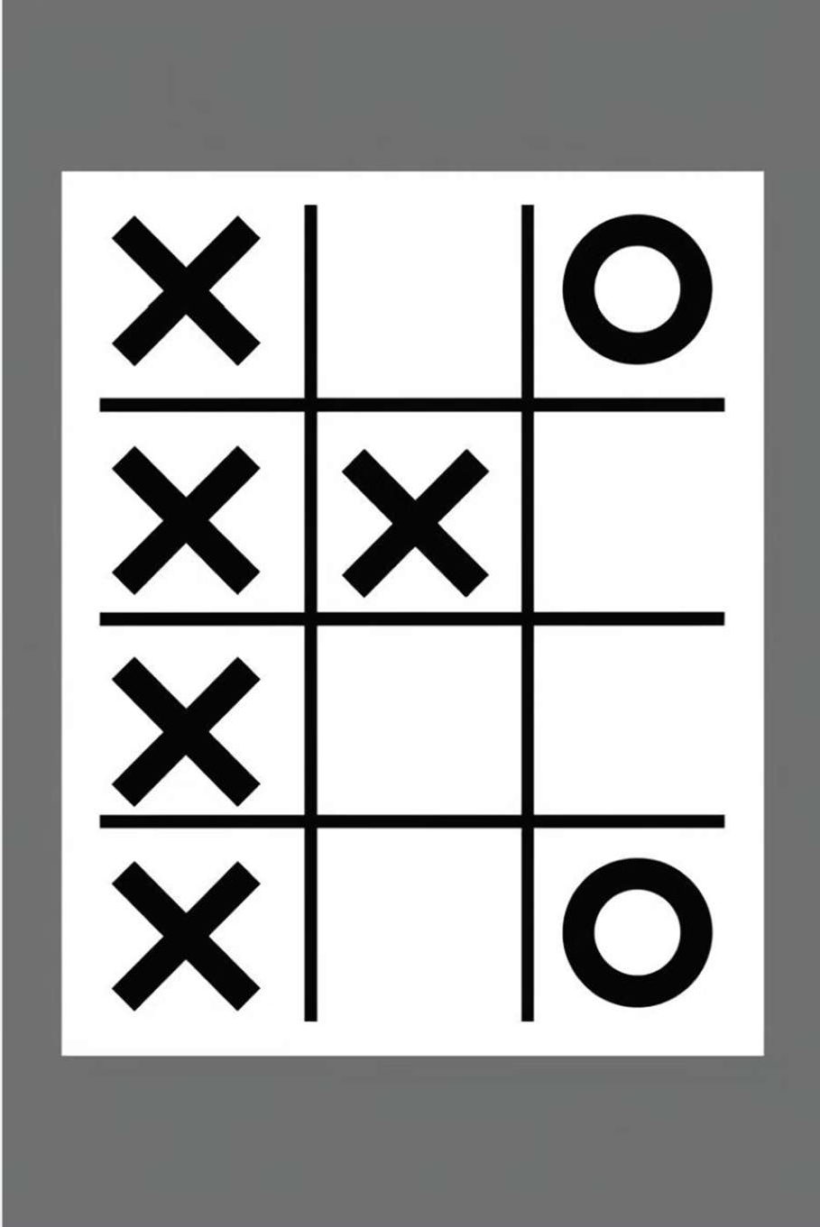


Tic-Tac-Toe: A Python Implementation
This presentation explores a classic game - Tic-Tac-Toe - implemented using Python programming. We will delve into the code, its functionality, and the logic behind the game's mechanics. Let's learn how to create this timeless game in Python.

Slide 2

Problem Statement
Our goal is to write a Python program that allows two players to play Tic-Tac-Toe. The program should handle player turns, validate moves, check for wins, and declare a draw if the game ends without a winner. We will also explore the use of Python lists to represent the game board.
Core Functionalities
1. Display the game board.
Technical Approach
1. Use a Python list of lists to represent the game board.
2. Take player input for their move.
2. Implement functions for validating moves, checking for wins, and detecting a draw.
3. Validate the move and update the board.
4. Check for a win condition after each move.
3. Use loops to manage player turns and game flow.
4. Provide visual feedback to the players about the game state.
5. Determine if the game has ended in a draw.

Slide 3
Technology - Package Used in the Project
The Python program utilizes built-in Python libraries. These libraries provide the necessary tools for working with input and output operations, data structures, and program control flow. The program does not use any external libraries or packages.
1
1. Input/Output
The program uses the `input()` function to receive user input for the game's moves. It uses the
`print()` function to display the game board and messages to the players.
2
2. Lists and Data Structures
Python lists are used to represent the Tic-Tac-Toe board. Lists provide an efficient and convenient way to store and manipulate the game's state.
3
3. Control Flow
The program uses `while` loops to manage player turns and continue the game until a win or draw condition is met. `if` statements are used to validate moves, check for wins, and manage the game's logic.

Slide 4
Program Code
def display_board(board):
"""Prints the current state of the Tic-Tac-Toe board.""" for row in board:
print("|", " | ".join(str(x) for x in row), "|") def is_valid_move(board, move):
"""Checks if a given move is valid on the current board.""" row, col = move // 3, move % 3
return 0 <= row < 3 and 0 <= col < 3 and board[row][col] == " " def check_win(board, player):
"""Checks if the given player has won the game."""
win_conditions = [[(0, 0), (0, 1), (0, 2)], [(1, 0), (1, 1), (1, 2)], [(2, 0), (2, 1), (2, 2)],
[(0, 0), (1, 0), (2, 0)], [(0, 1), (1, 1), (2, 1)], [(0, 2), (1, 2), (2, 2)],
[(0, 0), (1, 1), (2, 2)], [(0, 2), (1, 1), (2, 0)]]
for condition in win_conditions:
if all(board[row][col] == player for row, col in condition): return True
return False
def is_board_full(board): """Checks if the board is full.""" for row in board:
for cell in row:

Slide 5
Program Outputs
Game Start
The program begins by displaying an empty game board. The player 'X' is prompted to enter their first move (a number between 1 and 9 representing the board position). The program validates the move, updates the board, and displays the updated board. This process continues for each player's turn.
Win Condition
If a player makes a move that satisfies the win condition (three of their symbols in a row, column, or diagonal), the program displays the final board and declares the winning player. The game then ends.
Draw Condition
If all nine spaces on the board are filled without a winning move, the program displays the final board and declares a draw. The game then ends.

Slide 6
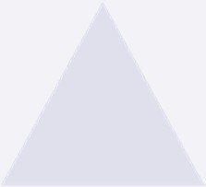




Functions: Building Blocks of the Game
main
The main function orchestrates the game's flow. It initializes the board, handles player turns, and calls the other functions to validate moves, check for wins, and determine a draw.
1
2
display_board
This function prints the current state of the board, allowing players to visualize the game.
is_valid_move
This function determines if a player's chosen move is valid (within the board's bounds and on an empty space).
3
check_win
This function checks if the current player has made a winning move (three symbols in a row, column, or diagonal).
4
is_board_full
This function determines if the board is full, indicating a draw condition if no player has won.
5

Slide 7
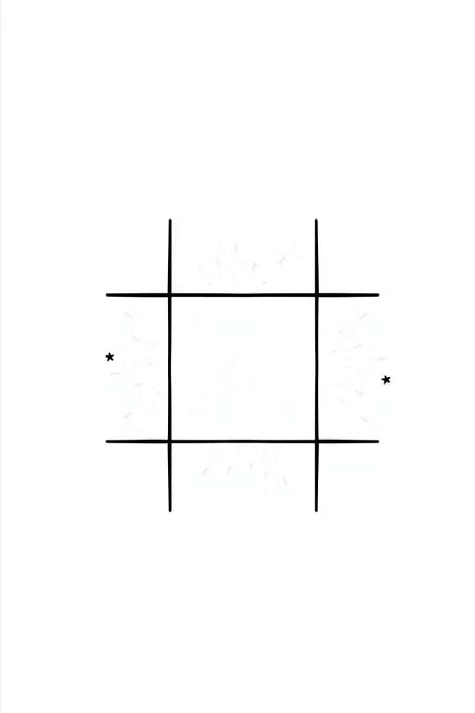
Key Takeaways
1
1. Lists as Data Structures
Python lists provide a powerful way to represent data structures like the game board. They allow for easy access and modification of elements.
2
2. Function-Driven Programming
Breaking down the game logic into functions improves code readability, reusability, and maintainability.
3
3. Game Logic Implementation
The code demonstrates how to implement game logic using conditions, loops, and function calls to handle player turns, validate moves, check for wins, and determine a draw.

Slide 8



Next Steps: Enhancing the Game
AI Opponent
Implement an AI opponent that can play against human players. This can be achieved using algorithms like minimax or Monte Carlo Tree Search to make intelligent moves.
Multiplayer
Enable two players to play against each other over a network. This could be achieved using sockets or libraries like
`asyncio` for network communication.
Graphical Interface
Create a graphical interface using libraries like Tkinter or Pygame to enhance the user experience and provide visual feedback.

